Slide 1
An Analysis of Generational Drug Use
Lily Franks, Shruthi Srinivasan, Haoxuan Lu, Michael Handler
Notes:
Michael:
In this video we will provide an analysis of generational drug use. Being college students surrounded in an environment that seems to foster recreational drug use, we all find this topic particularly interesting.
The use of psychoactive substances is not new in human history.
Archaeological evidence tells us that shamans had begun using medicinal plants in the Paleolithic Age, approximately 60,000 years ago and by the 17th century, modern-day concepts of addiction were being observed
In this report, we will further analyze drug use by examining different generations in the United States.
We are interested in learning more about the fluctuation, if any, of drug habits across generations in the United States.

Slide 2
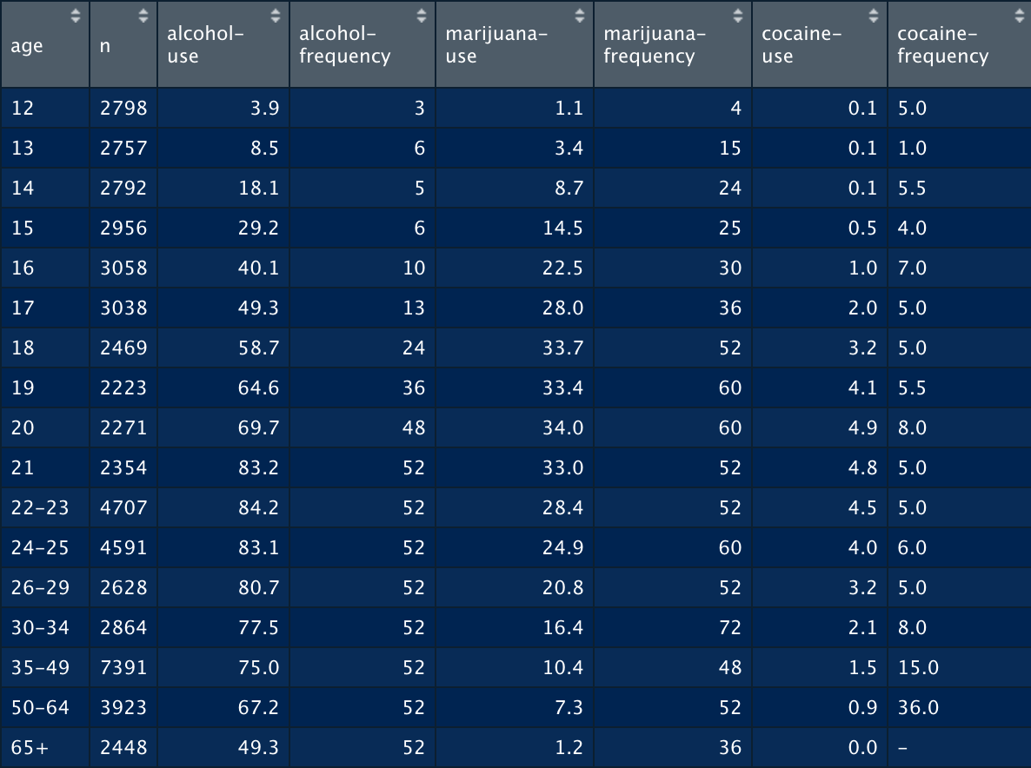
Notes:
Haoxuan:
These are 8 of the 28 columns in our original dataframe we read in.
As you can see there is a column for age which represents an age group and the column n representing the population of the specified age group.
There are 13 drugs split into two sub-categories: use and frequency.
The use variable for each drug, such as alcohol-use, represents the percentage of those in an age group who used that particular drug within the past 12 months.
And the frequency variable for each drug, such as alcohol-frequency, represents the median number of times a user in an age group used this drug within the past 12 months.
You can also find that there are missing values on frequency columns such as the cocaine frequency for those over 65 years old. That is due to researchers found very few people or no people used this drugs.

Slide 3
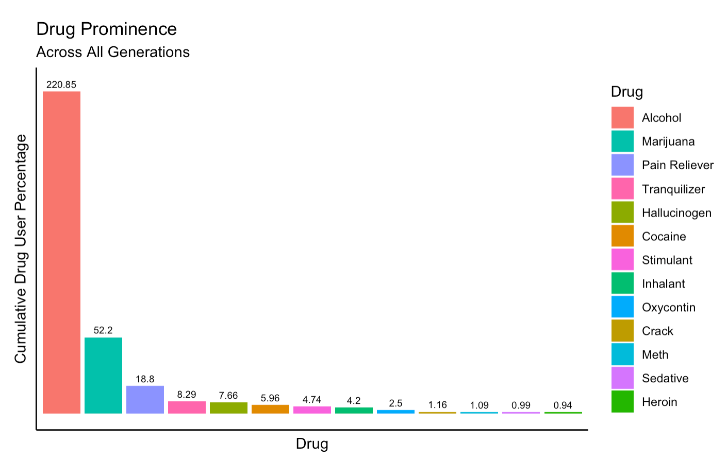
Notes:
Michael:
The displayed graph shows all 13 drugs analyzed in our data report as well as the prevalence of use in our sampled population.
This was done to give some background and context of the drugs’ usage & popularity overall as well as to efficiently display what drugs we focus on.
You’ll notice there are 6 subcategories included - Pain Reliever, Tranquilizer, Hallucinogen, Stimulant, Inhalant & Sedative.
Because the list substances that fall under the umbrella of these respective categories are so extensive, researchers grouped them.
During the survey, subjects were asked exactly which drugs that would fall under these categories—this is listed in our report.

Slide 4
How does the drug use percentage of the most popular drug(s) compare across each generation?
Notes:
Shruthi:
The main question we aim to address is how does the drug use percentage of the most popular drugs compare across each generation?
We hypothesise that among younger generations (Gen Z and Millennials) the drug use percentage will be higher than that of the older generations (Gen X and Boomers
The oldest of the younger generation is only 29, meaning that they have recently graduated, may still be in school, or are just entering the workforce. The youngest of the younger generation is only 12 and we expect them to be beginning middle school. Therefore, we believe the younger generations are more likely to be victims of risk factors such as low grades or failure in school, permissive parenting, low self esteem, parent or older sibling drug/alcohol use, etc.,11. These risk factors pose a unique threat to developing minds and we expect the drug use percentage to be significantly higher as a result.

Slide 5
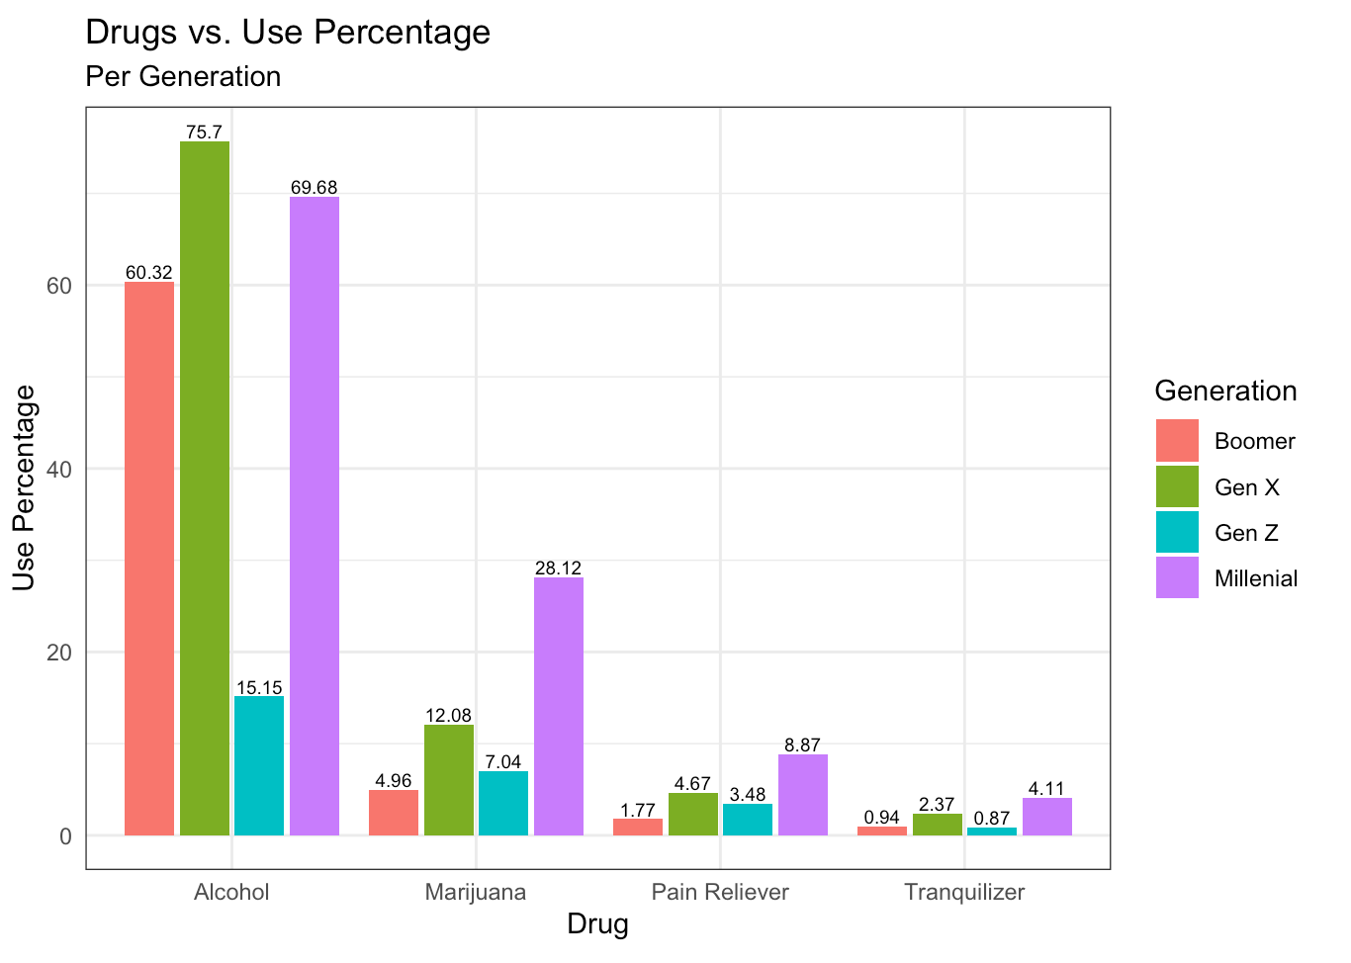
Notes:
Haoxuan:
Methods:
We originally hypothesized that the younger generations (Gen Z and Millenials) would have higher use percentages than that of the older generations (Gen X and Boomers). The graph we’ve obtained allows us to observe the relationship between drug use percentage across the four most prominently used drugs and each generation. In order to produce our graph to test this theory, we manipulated the data by grouping each age group. In order to show the use percentages for each drug per generation, we will use the overall sum of the drug use percentage multiplied by the population per generation and divide that value by the overall population. We will then order the drugs based on the numerical value per drug use percentage, giving us the four most prominently used drugs. Using these selected drugs and the manipulated data, we can graph each generation’s various drug use percentages next to each other.
In this graph, we can see that Millenials and Gen X take the lead of drug use percentage across all prominently used drugs.
Lily:
Discussion:
As we begin to analyze the most popular drugs and their use among each generation, we can see that Millennials have the highest drug use variability compared to the other generations, yet not the highest overall use percentage. Gen X’s use percentage is the highest for alcohol, and Gen Z seems to fall behind in three of the four drugs. We expected Millennials’ and Gen Z’s usages to be the highest, yet, given the age of the data, a lower percentage should be expected as Gen Z was only 12-15 years old in 2012.
Millennial drug use is extensive compared to the other generations, with 4 to 8 times the use percentages of other generations. Given the age range of Millennials this is to be expected as it encompasses late-teen to late-college years, which is colloquially known as a time of partying and newfound freedom, which would lead to higher drug use.
Overall, our original hypothesis was proven only partially correct since we predicted Millenials and Gen Z’s to have the highest drug use percentages across all generations. Further analysis of this could include whether or not Gen Z uses drugs at the same percentage that Millenials did when they were the same age. Additionally, new data encompassing a generations lifetime would help us better analyze generational drug use.

Slide 6
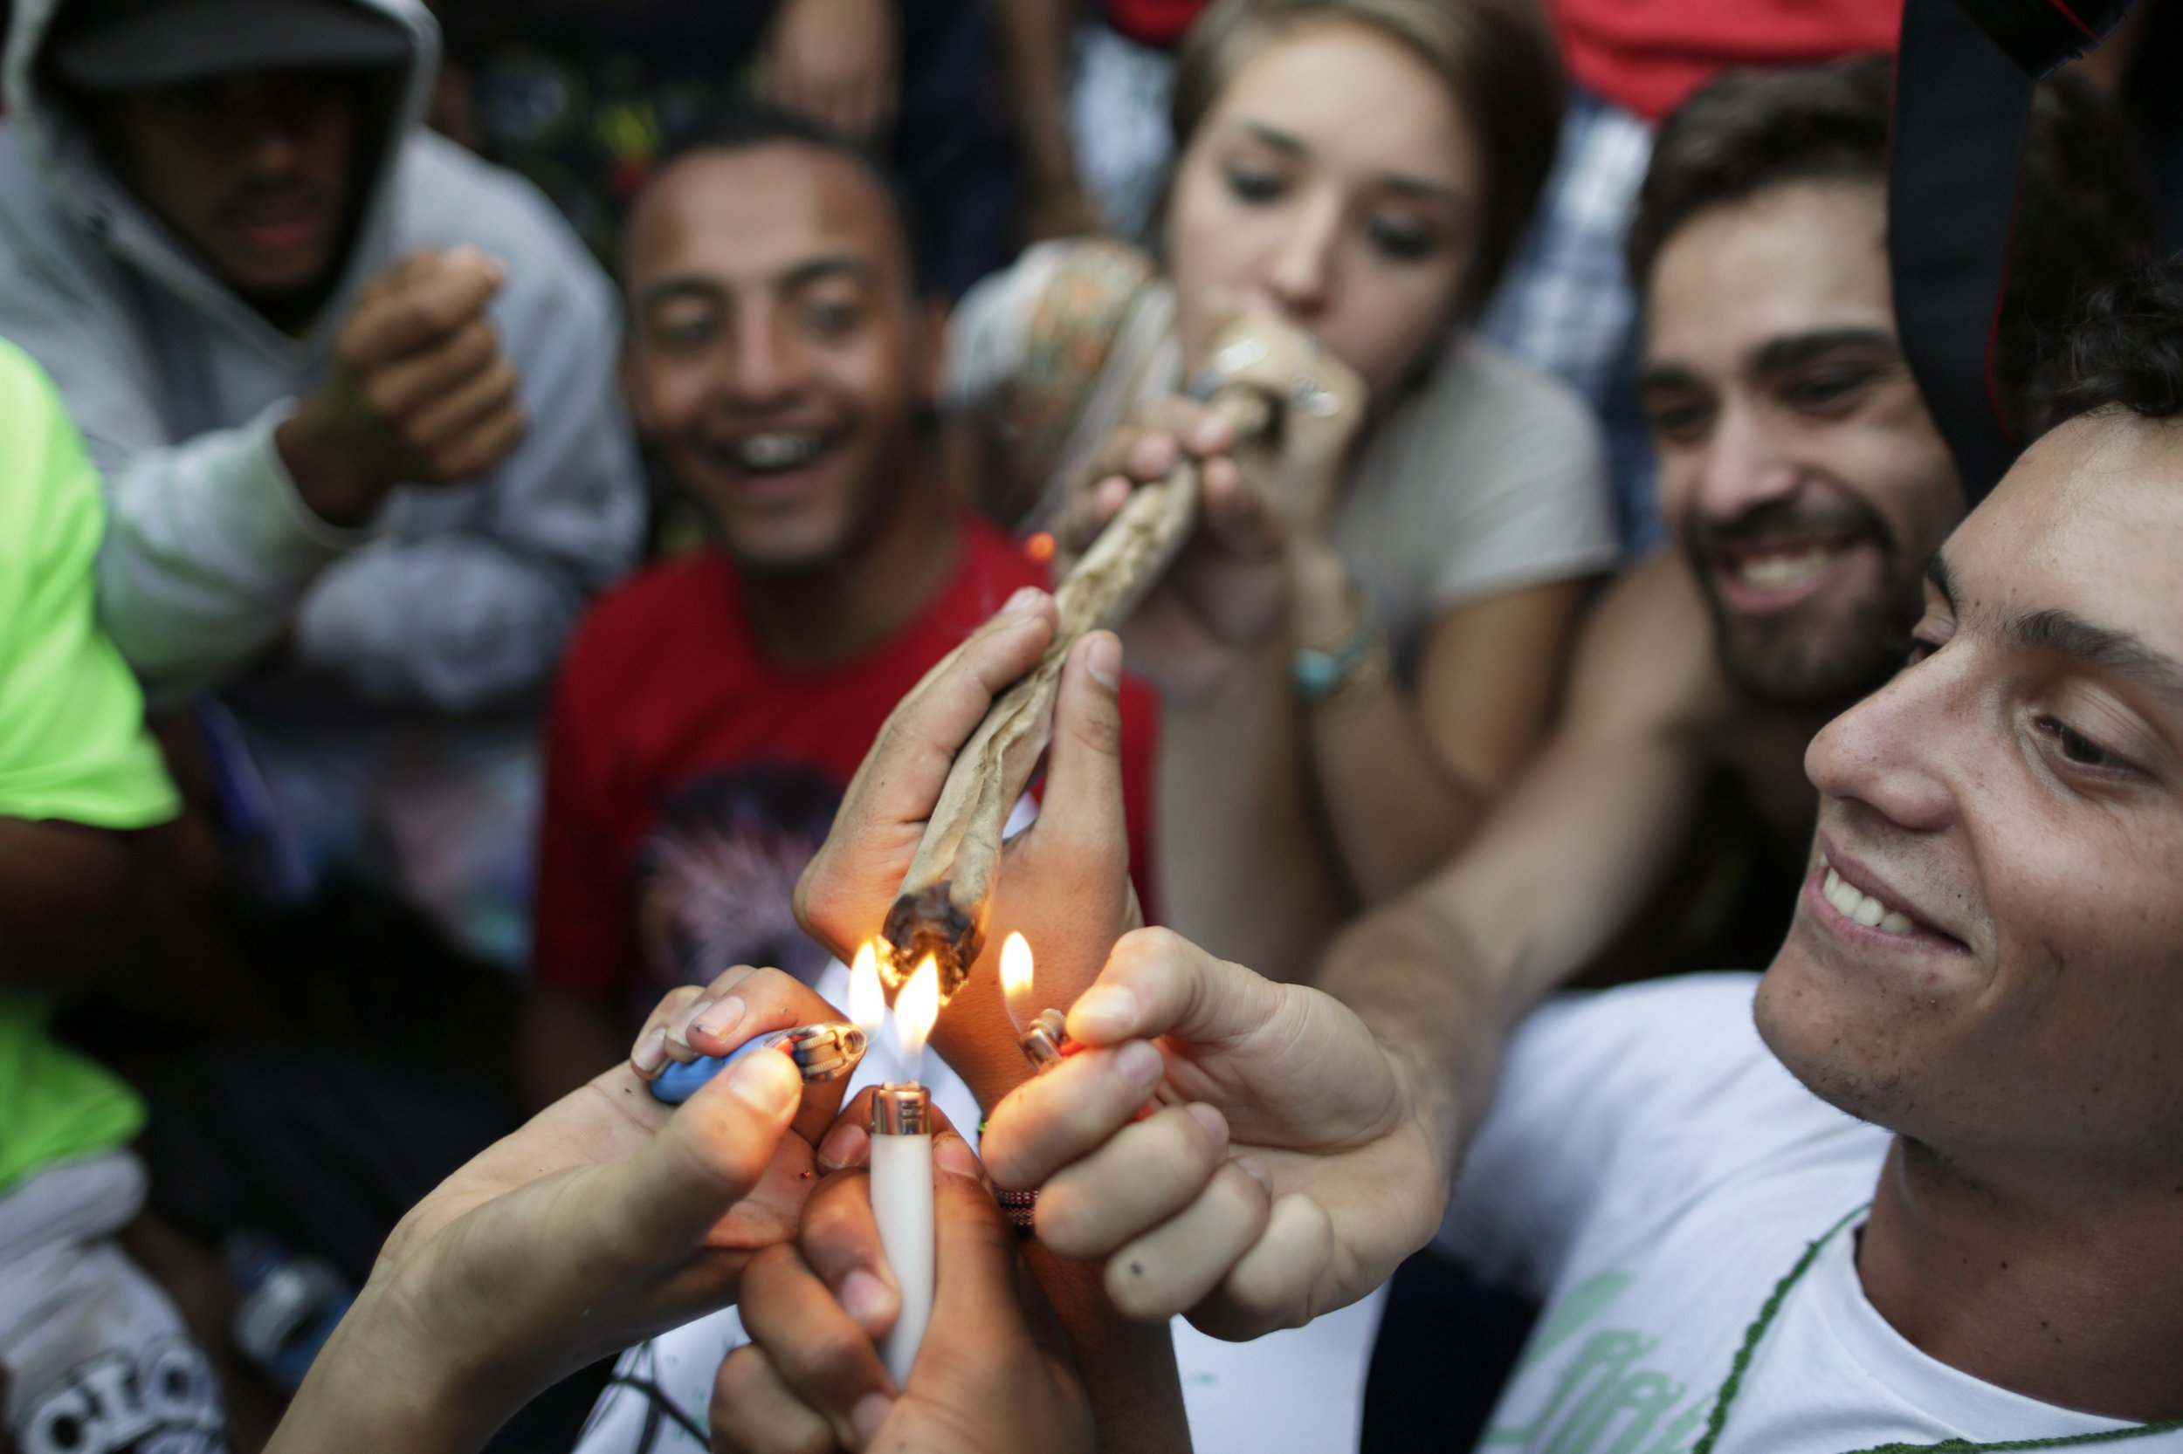
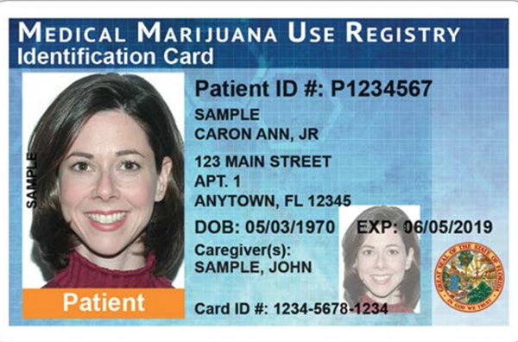
Shortcomings
Recreational Use
Medicinal Use
Left: https://www.newsweek.com/weed-smoking-teens-60-less-likely-finish-high-school-study-says-269647
Right: https://www.orlandoweekly.com/orlando/heres-what-its-actually-like-to-get-your-medical-marijuana-card-in-florida/Content?oid=25146720
Notes:
Shruthi:
Before we talk about future analysis lets review some shortcomings presented with this data. First, our data is from 2012 making it hard to fully analyze in modern-day context as social norms and expectations may have changed in the last 8 years.
Furthermore, there are some other factors that could have resulted in false data/misinformation. namely: difficulty acquiring desired drugs due to age limits, fear of accurately reporting drug use, and desirability vs necessity.
First,
The youngest Millennials in 2012 were 16, which makes us question the authenticity of this data as being uderage presents difficulty in acquiring even common drugs, such as alcohol and marijuana, aside from the others. Furthermore, if we collected data in 2020, we would expect Millenial and Gen Z alcohol and marijuana usage to be higher, due to their coming of age within the past 8 years.
Second, People want to portray themselves favorably, making them reluctant to admit to an answer they may consider disagreeable. Because the topic concerned is socially taboo, respondents may change their answer to one they perceive is more socially desirable.
The last issue is desirability versus necessity. While some drug use is correlated to desire, others use drugs for medical reasons. It’s important to note this as we believe this data is comprised of people who either desire, do not desire, or are neutral towards drug usage.

Slide 7
Future Analysis
Notes:
Lily:
Further analysis would include whether or not Gen Z uses drugs at the same percentage that Millenials did when they were the same age. The same question could also be applied to other generations— Boomers seem to have the lowest drug use now, but were they using at the same rates as Millenials at ages 16-29? Ultimately, if we could have new data encompass drug use across a generations lifetime, it would help us better analyze generational drug use across time, rather than across a single year.
Now that we have a grasp on understanding how generations use drugs, we move towards exploring why generations use drugs. Questions like do certain risk factors pose a heavier threat to certain generations, how do risk factors vary from generation to generation, and are there positive factors associated with decrease of drug use with each generation could help us understand the motivation behind drug use.

